Slide 1
Open Source for Navigation
Xun Liu
4/10/2019

Slide 2
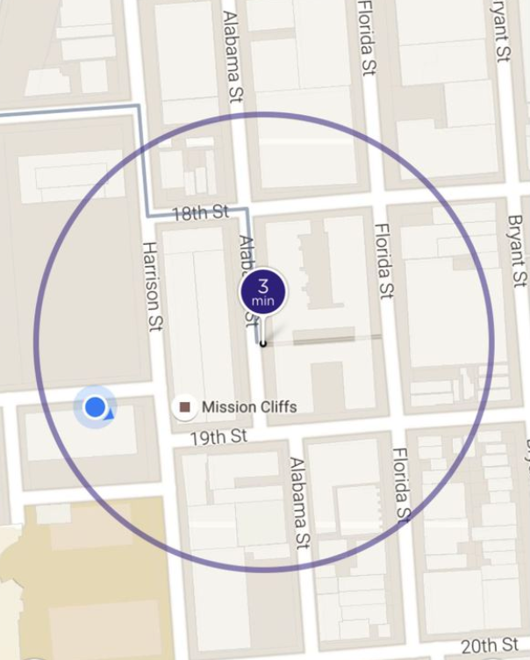
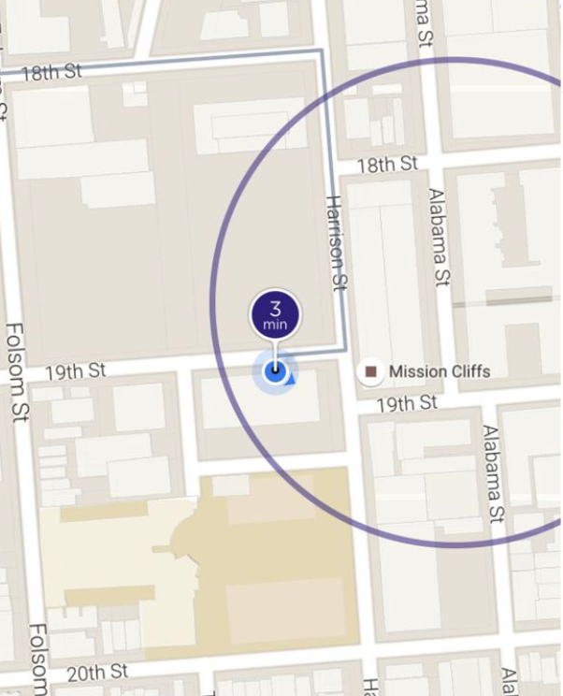
Map Matching when the map is wrong
A story about Lyft pick up
When Map data exists
No Map data
Notes:
The original picture tells the feature of destination adjustment from Lyft

Slide 3
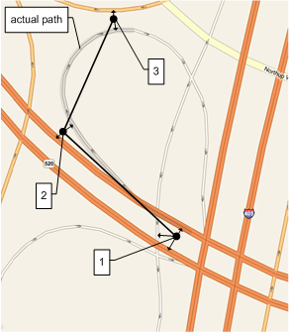
Offline Map Matching
What/How/Why
Give a sequence of GPS signals, find the most probable sequence of road segments

Slide 4
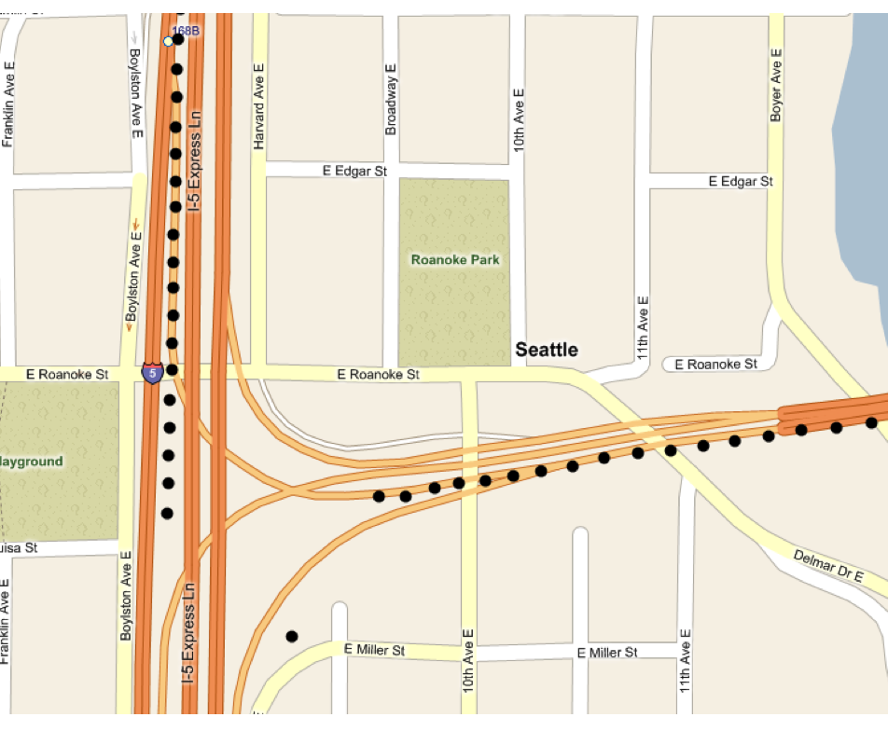
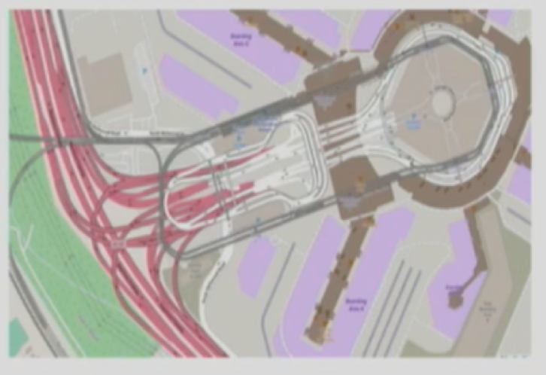
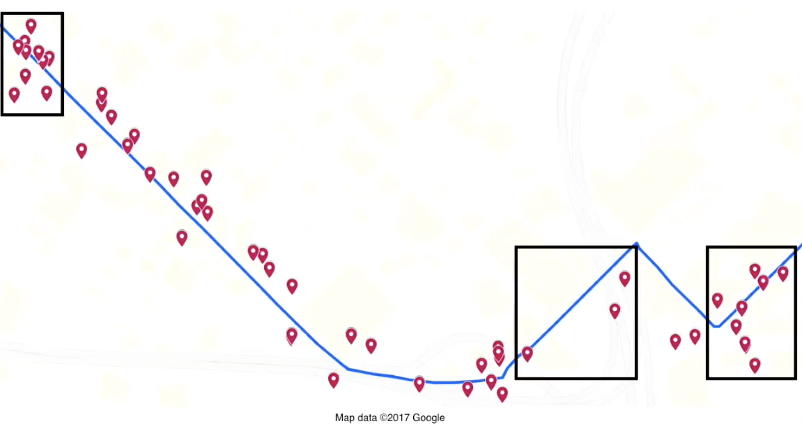
Offline Map Matching
What/How/Why/
Noise
Sparseness
Missing GPS
Wrong map data

Slide 5

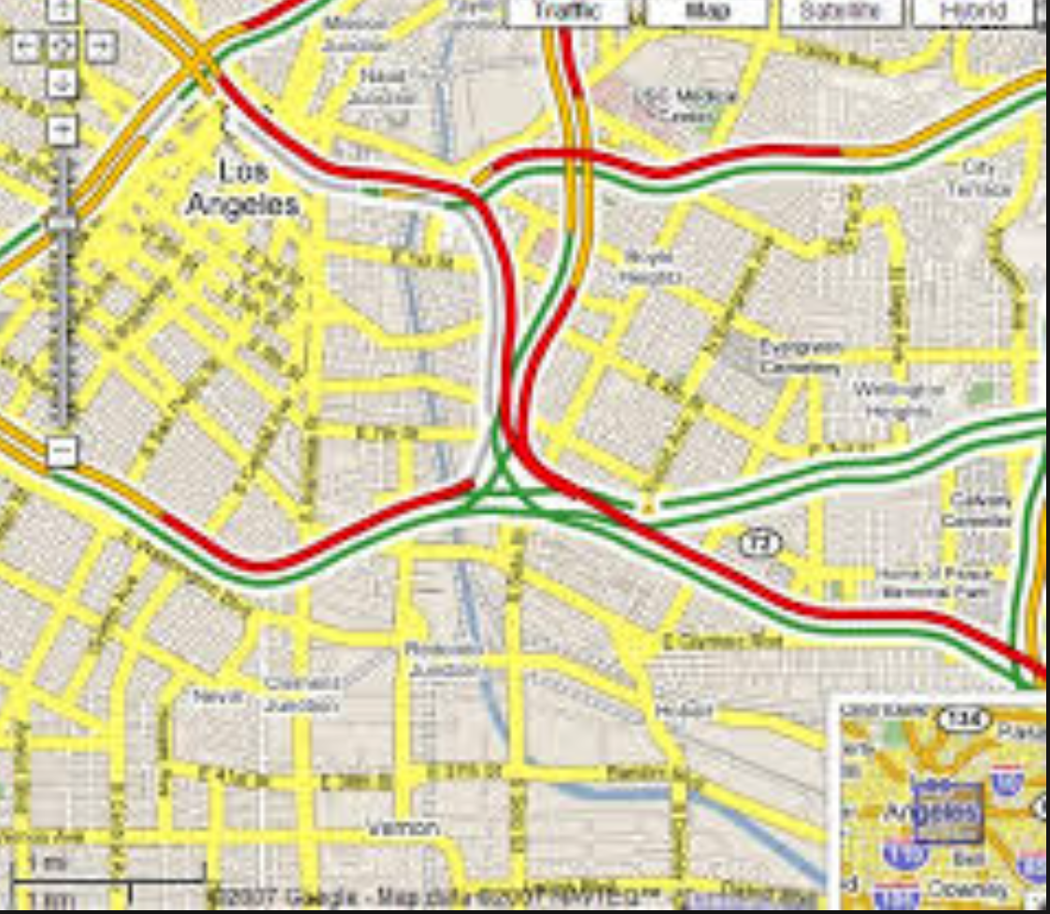
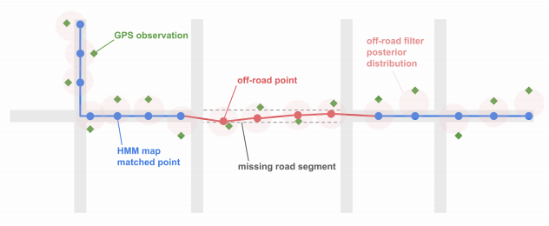
Offline Map Matching
What/How/Why
Historic/Live traffic
Enhance map data
User pattern
Notes:
Live traffic
Enhance map data
Analysis user pattern

Slide 6
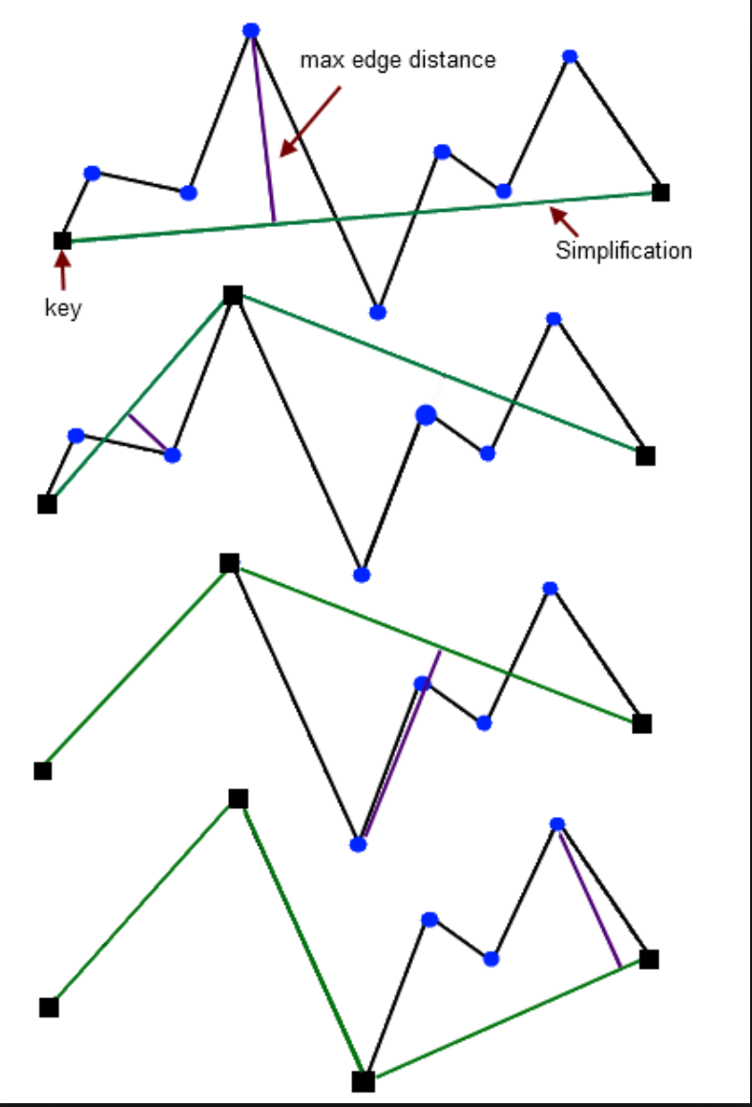
Map Matching logic
Lifecyle
Simplify points
Filter noise points
Find Nearest edges as Candidate
Consider trend
Optimal path

Slide 7
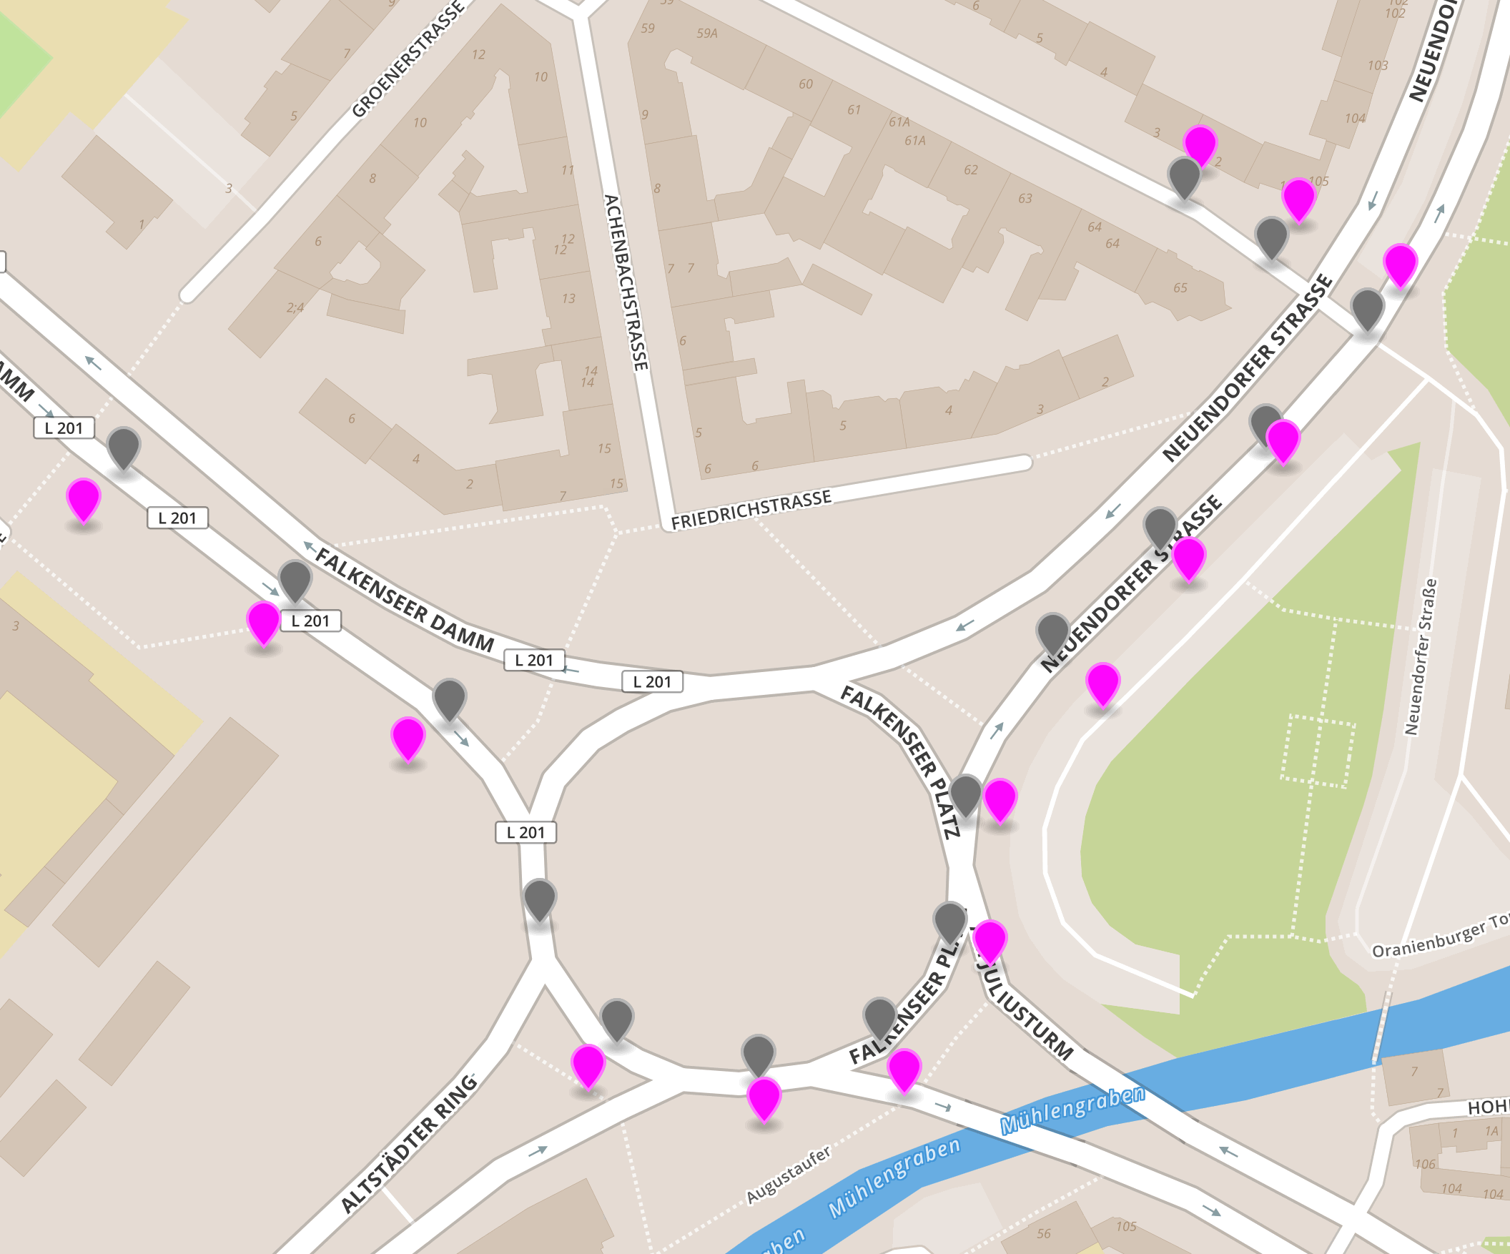
Map Matching logic
Lifecyle
Filter dense points
Filter noise points
Find Nearest edges as Candidate
Consider trend
Optimal path

Slide 8
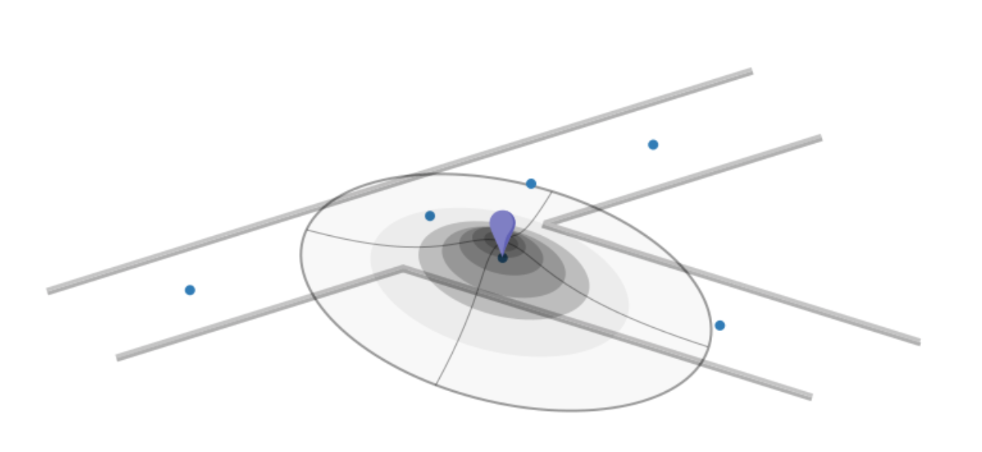
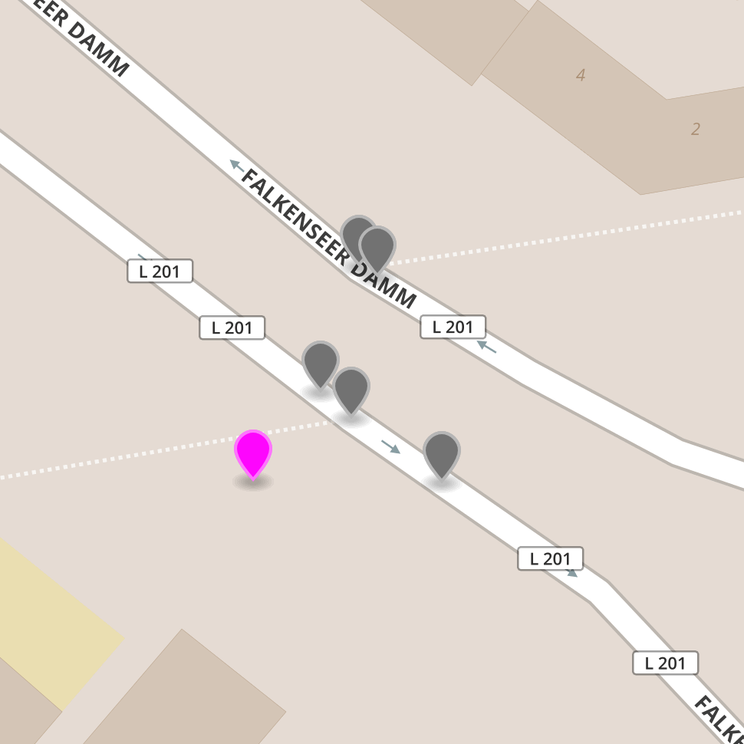
Map Matching logic
Lifecyle
Filter dense points
Filter noise points
Find Nearest edges as Candidate
Consider trend
Optimal path

Slide 9
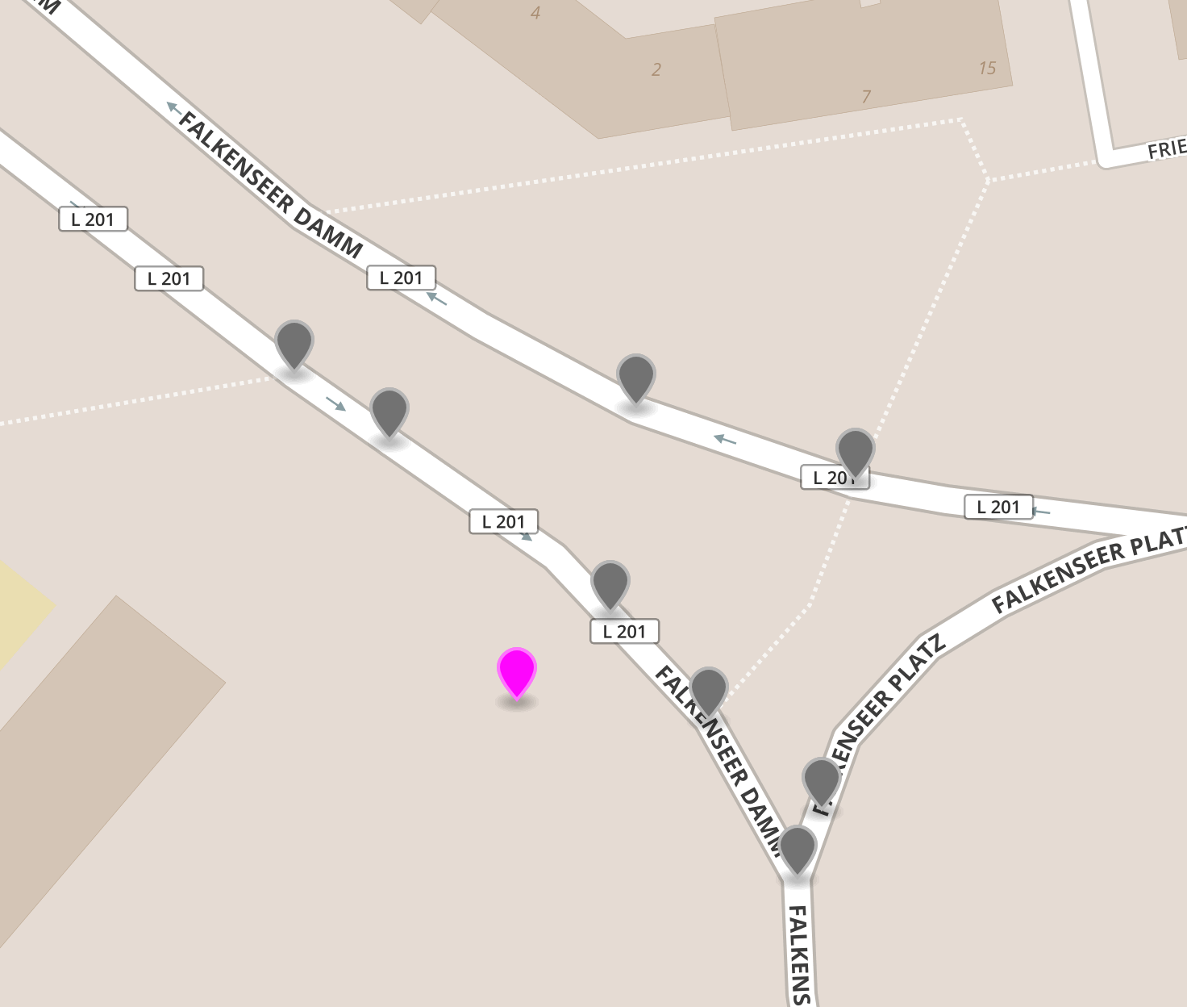
Map Matching logic
Lifecyle
Filter dense points
Filter noise points
Find Nearest edges as Candidate
Consider trend
Optimal path

Slide 10
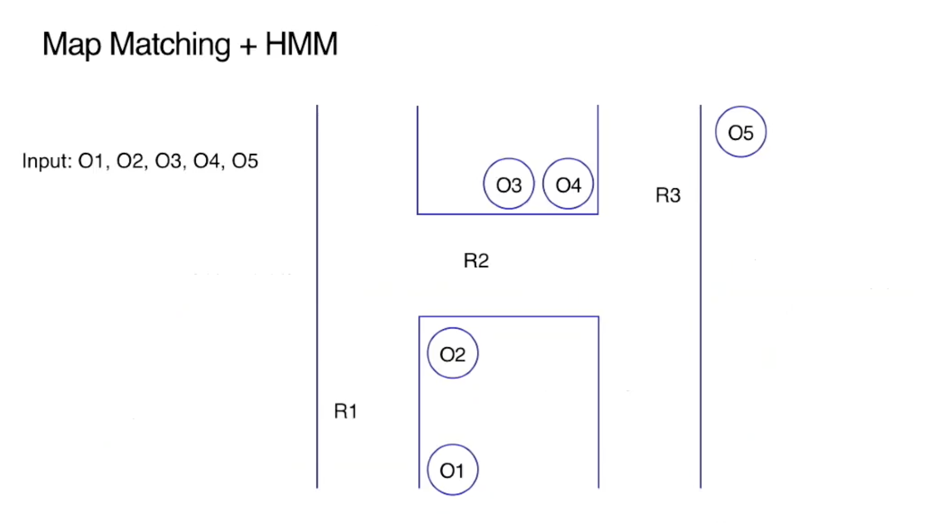
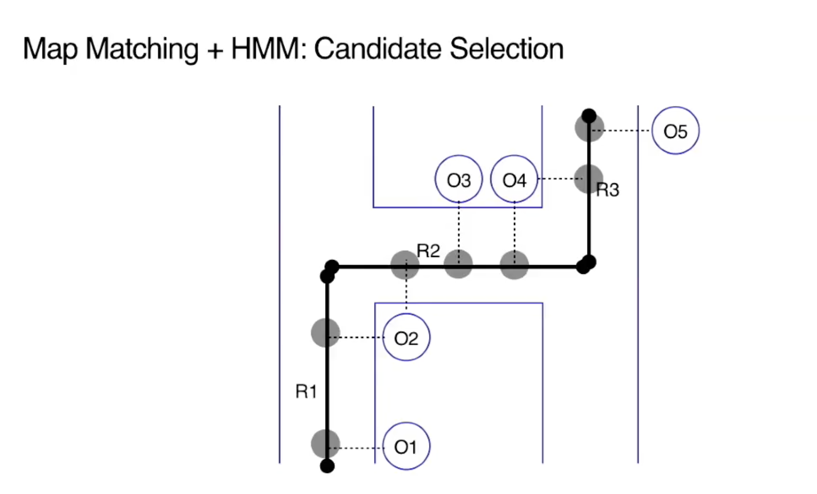
Map Matching logic
Lifecyle
Filter dense points
Filter noise points
Find Nearest edges as Candidate
Consider trend
Optimal path
Notes:
HMM -> Emission Cost -> Transition Cost
Dynamic programming

Slide 11
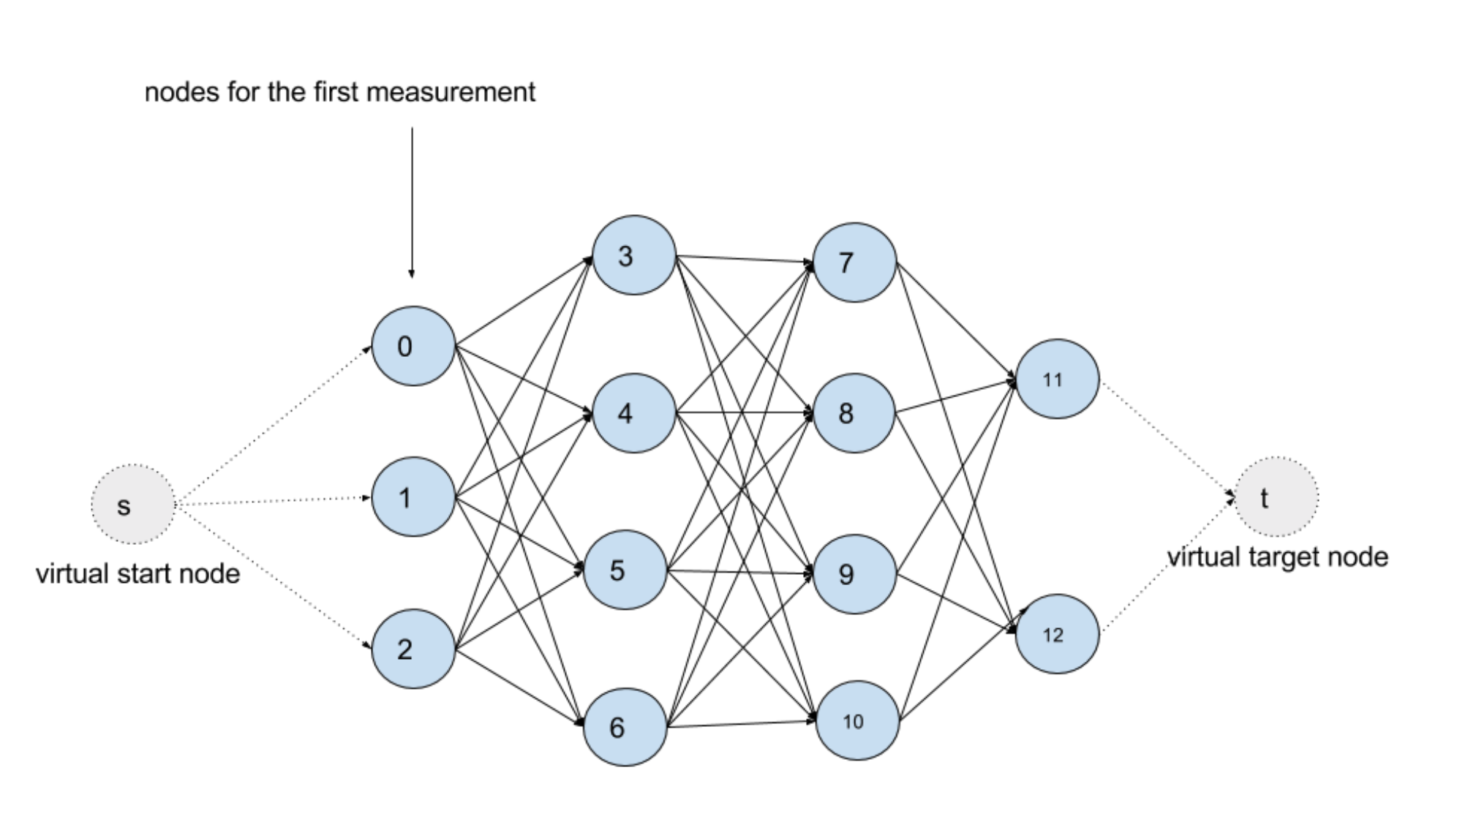
Map Matching logic
Lifecyle
Filter dense points
Filter noise points
Find Nearest edges as Candidate
Consider trend
Optimal path
Notes:
HMM -> Emission Cost -> Transition Cost
Dynamic programming

Slide 12

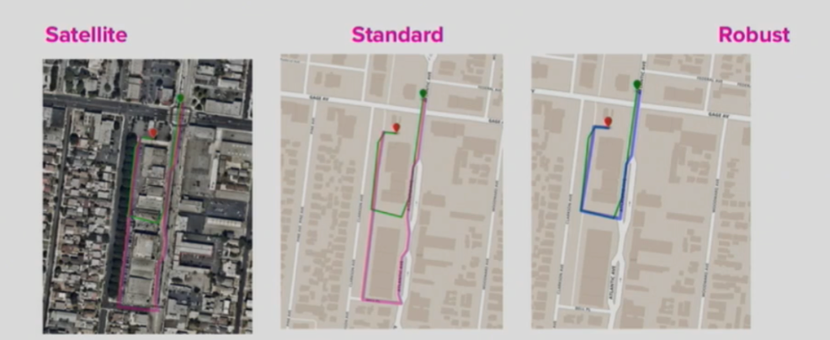
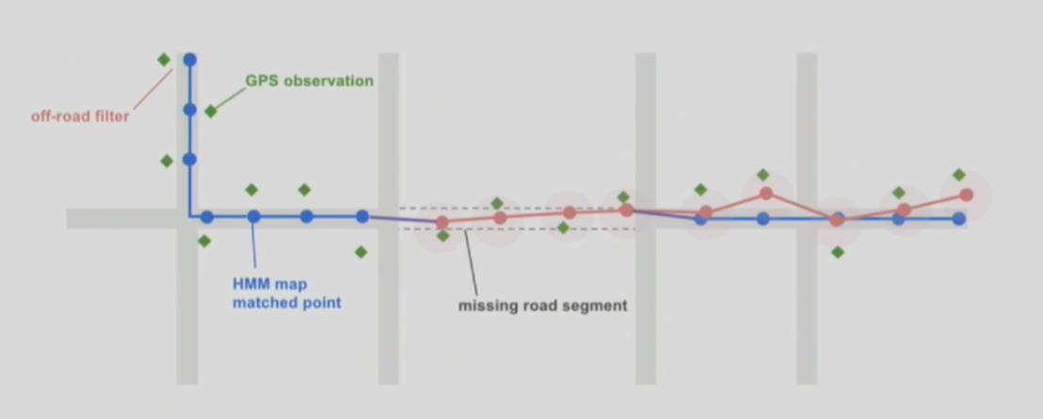

When map is wrong (LYFT’s way)

